Slide 1


Sentiment Analysis
Project 4 - Data Analytics
by Mylene Marsden

Slide 2



A global study of wine based on 1000 random samples from Kaggle
A
Top Wine-Consuming Countries
Countries with positive wine reviews.
Identify sentiment orientation (positive, neutral, and negative)
How tasters’ feel about a particular wine.
Identify the most frequent used words in the review
Mylene Marsden
Project 4 – Data Analytics

Slide 3
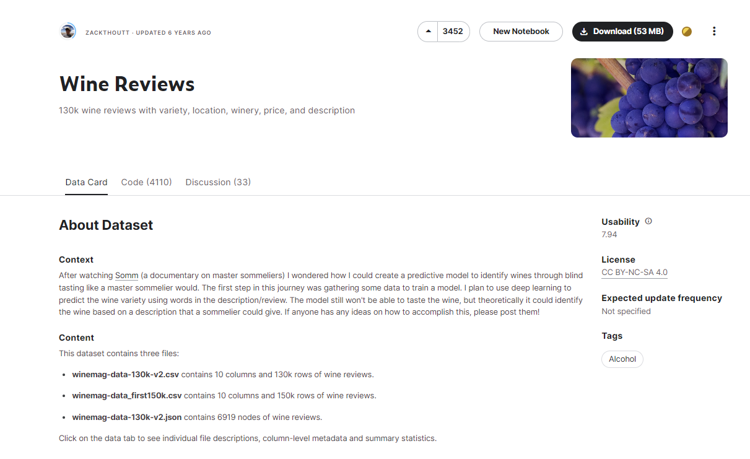
Data Source
LINK :
https://www.kaggle.com/datasets/zynicide/wine-reviews
An analysis of 1000 random samples of wine data obtained from Kaggle. ( “limit” 1000)
Mylene Marsden
Project 4 – Data Analytics

Slide 4
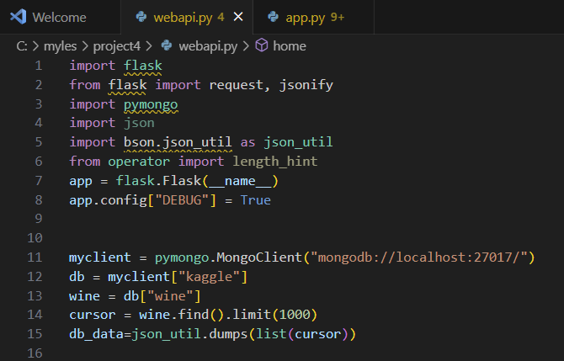
webapi
- “mongodb”’ database used
- created “webapi”
- used “flask” in wine data
Mylene Marsden
Project 4 – Data Analytics

Slide 5
webapi
http://127.0.0.1:5000/api/v1/resources/wine/all
-webapi response run locally
Mylene Marsden
Project 4 – Data Analytics

Slide 6
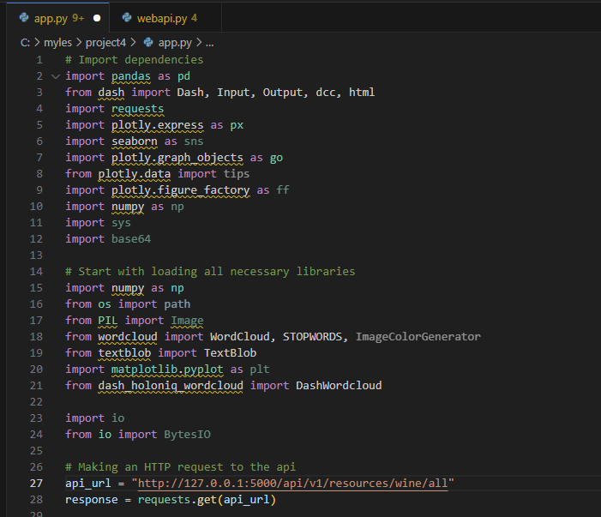
Dashboard
- using “dash” for dashboard
- using “plotly” for charts
endpoint being consumed by the dashboard
Mylene Marsden
Project 4 – Data Analytics

Slide 7
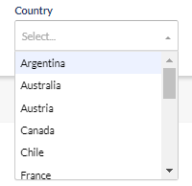
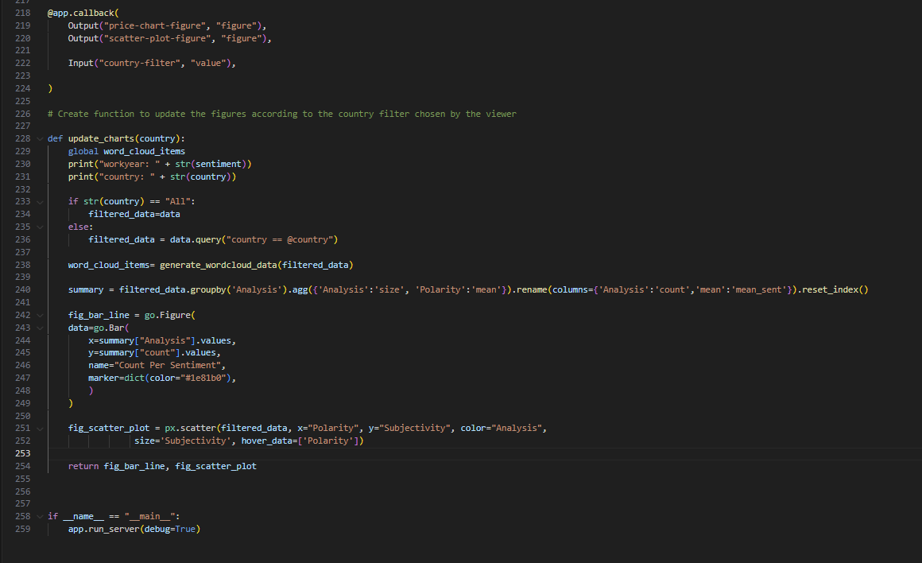
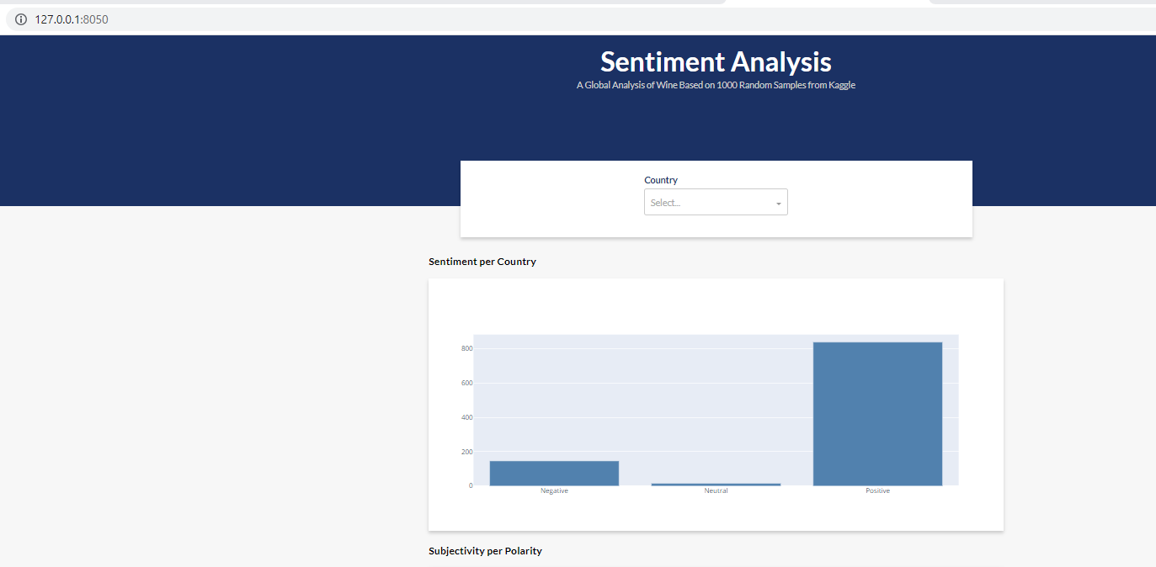
Dashboard - Filter
- Dashboard format / filter
by Country :
Link : http://127.0.0.1:8050/
Mylene Marsden
Project 4 – Data Analytics

Slide 8
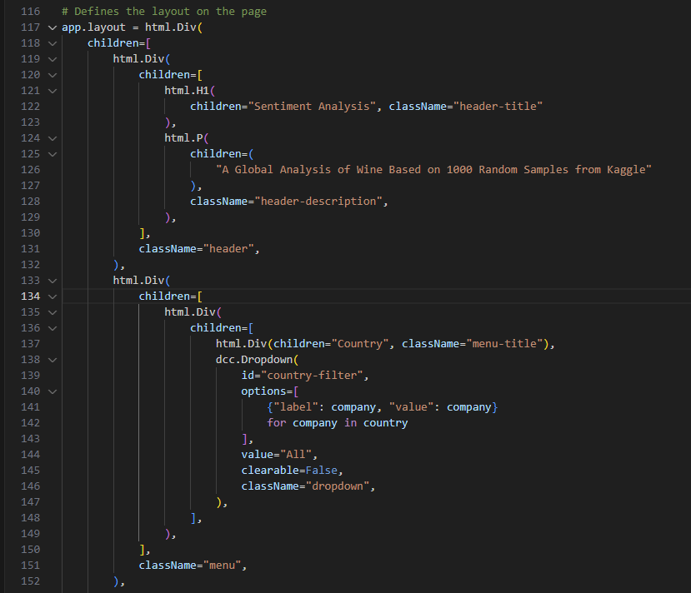
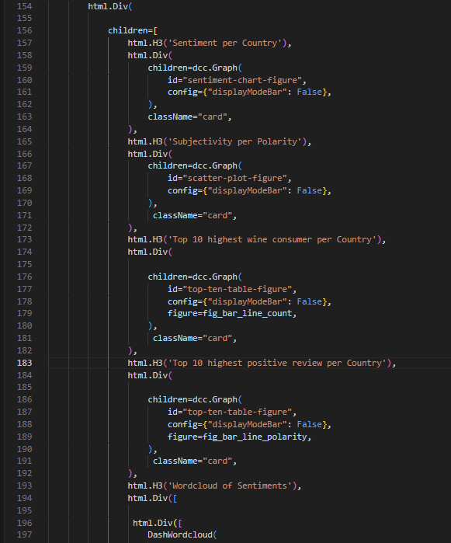
Dashboard Layout
Mylene Marsden
Project 4 – Data Analytics

Slide 9
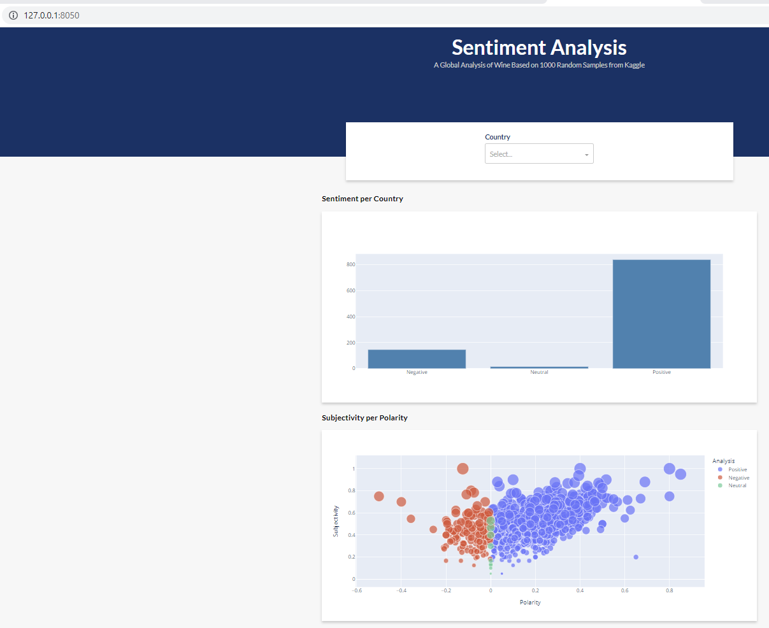
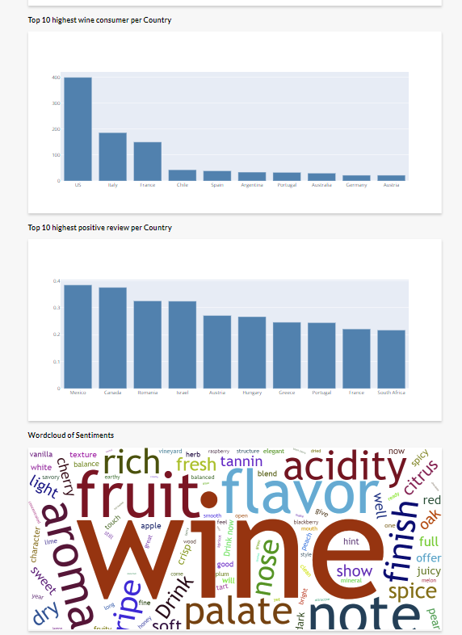
Dashboard Layout
Mylene Marsden
Project 4 – Data Analytics

Slide 10
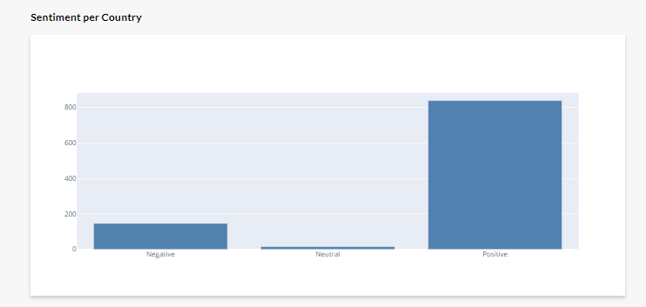
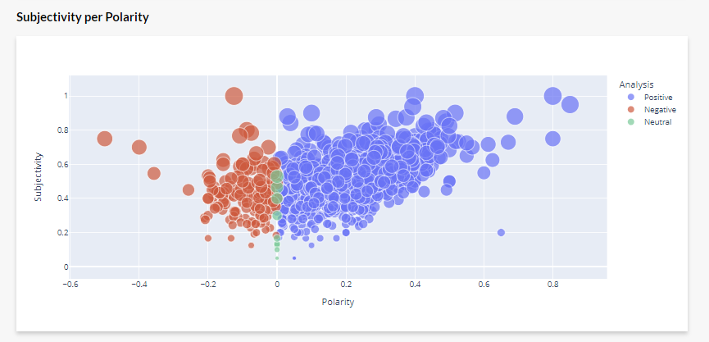
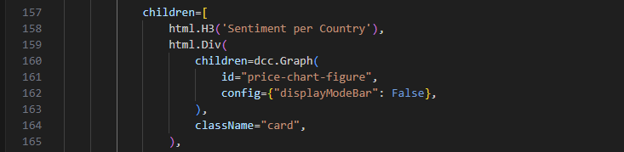
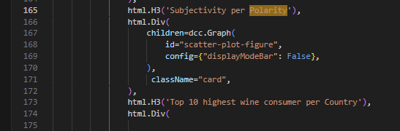
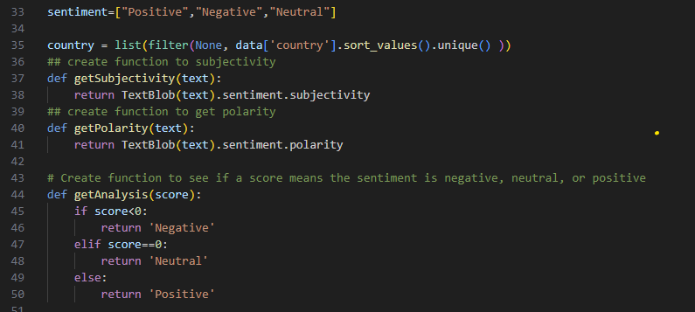
Dashboard Charts
Mylene Marsden
Project 4 – Data Analytics

Slide 11
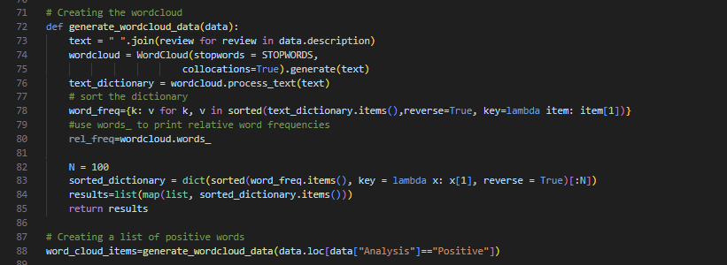
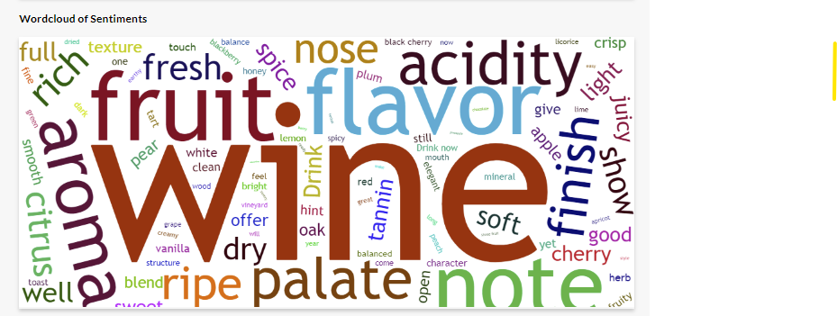
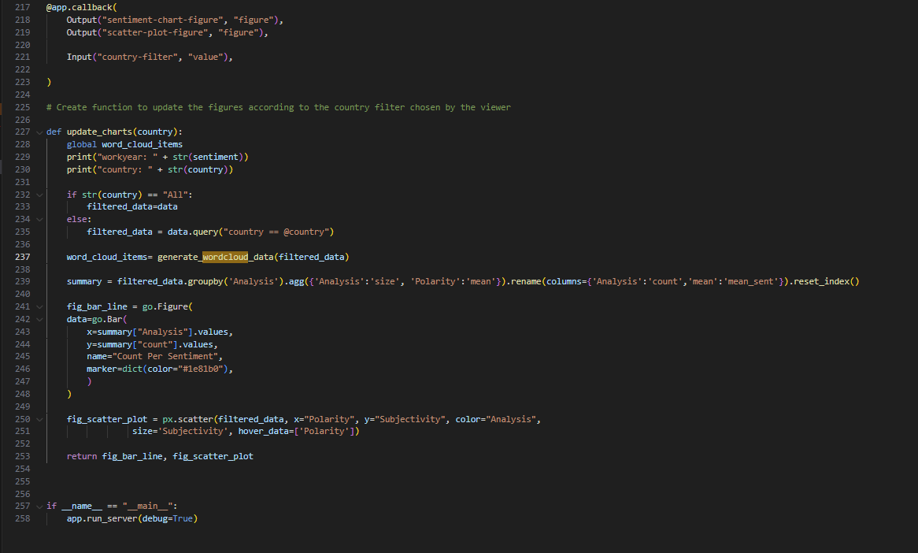
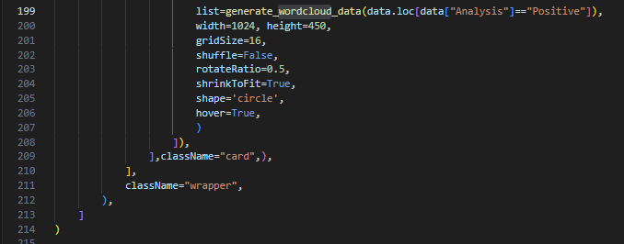
Dashboard Charts
Mylene Marsden
Project 4 – Data Analytics

Slide 12
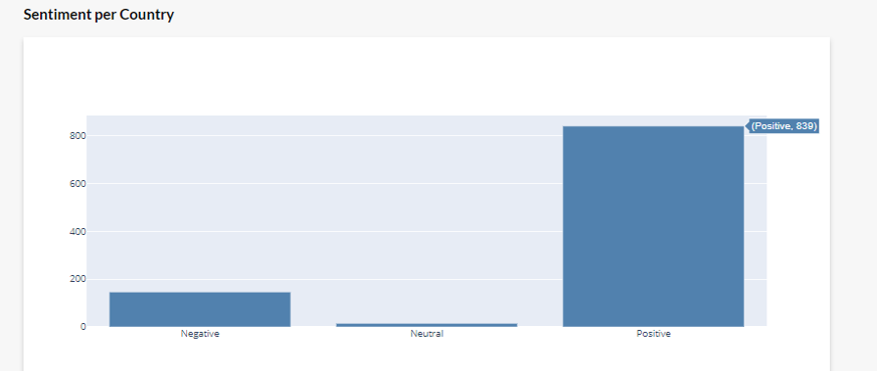
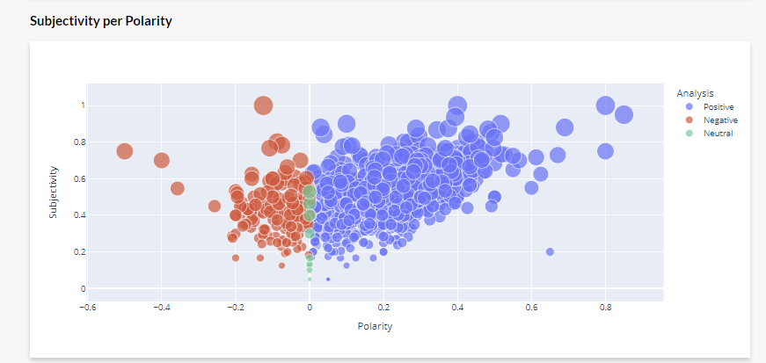
Wine Sentiment Analysis – Subjectivity vs Polarity Scores
The results indicate that 839 samples (83.9%) showed positive sentiments, while 146 samples (14.6%) showed negative sentiments.
It can be observed that the subjectivity scores of the 1000 samples were concentrated between 0.2 and 0.8. The majority of the data scores were predominantly in the middle of the scale, indicating a moderate level of subjectivity.
The dataset revealed a higher prevalence of positive polarity, with scores ranging from 0 to 0.5.
The dataset displays a smaller count of negative polarity scores, which range from 0 to -0.2.
Mylene Marsden
Project 4 – Data Analytics
Notes:
The results of the sentiment analysis on 1000 wine samples were impressive, with the majority of samples showing a positive sentiment. Out of the 1000 samples analyzed, 839 (83.9%) were found to have a positive sentiment, indicating that the consumers who made the review enjoyed them. On the other hand, only 146 (14.6%) samples showed a negative sentiment, suggesting that there were some wines that did not meet consumers' expectations or were not as well-received as others.

Slide 13
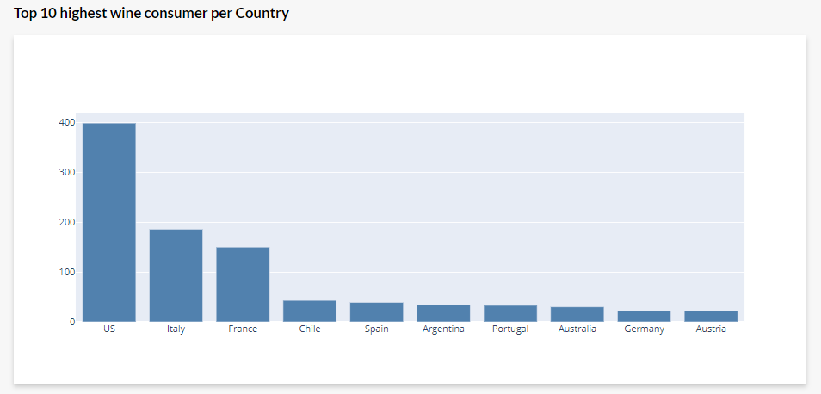
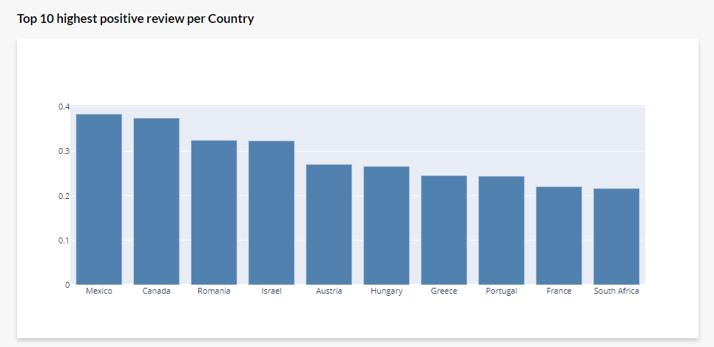
Top Wine-Consuming Countries, and Positive Reviews
According to the data analysed, the United States ranked first among the top wine consuming countries, followed by Italy, France, Chile, and Spain.
Mexico's wine industry are well-received by critics and consumers, ranking first among all countries in terms of positive reviews.
It can also be observed that Canada and Mexico have exhibited comparable outcomes, with Canada being a close second to Mexico.
Romania and Israel both ranked third and fourth, respectively, exhibiting comparable positive review results.
Notes:
According to the data, Mexico's wine industry has received positive feedback, making it the top-ranked country in terms of favorable reviews.
We can see also noticed here that Canada and Mexico have achieved similar review scores, with Canada coming in second to Mexico.

Slide 14
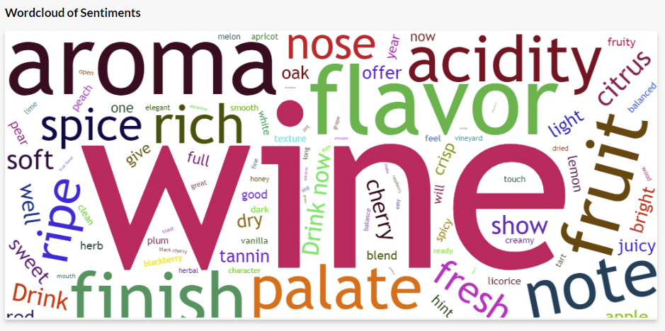
Wordcloud of Sentiments
The wordcloud analysis generated from positive wine reviews revealed that the most commonly used words were "flavor," "aroma," "acidity," "finish," "palate," "fruit," and "note.
The wordcloud presented highlights the key elements that contribute to the enjoyment of a great wine. These elements are deemed crucial as they enable the wine to be appreciated by a wide range of individuals.
Mylene Marsden
Project 4 – Data Analytics

